Slide 1
Machine Learning
with will

Slide 2

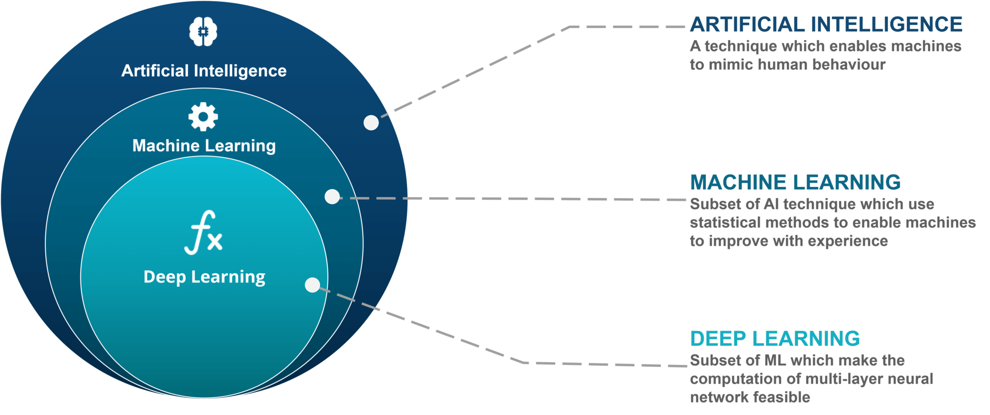
Machine learning

Slide 3
Some terminology first
Input layer | Input layer of the network
Hidden Layer | The layers in between the input and output layers
Output Layer | Output layer of the network
X | The input variables
Y_hat | The predicted values
Y | The real values

Slide 4
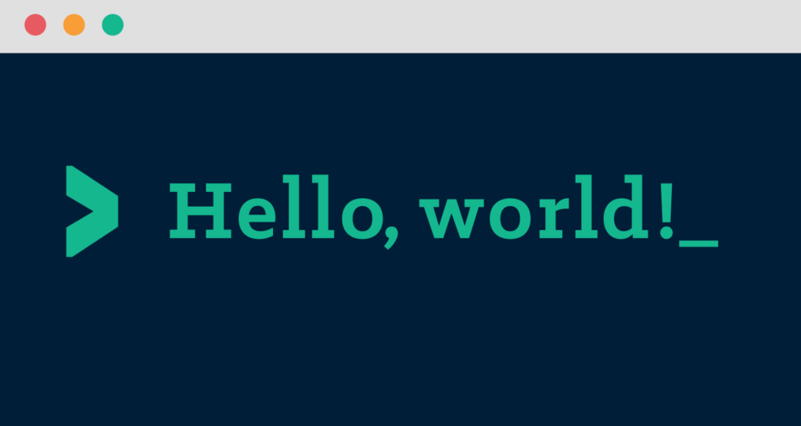
Hello World (Demo)

Slide 5
The simplest neural network in the world
Predicting a value based off 1 input value
X
Y_hat

Slide 6
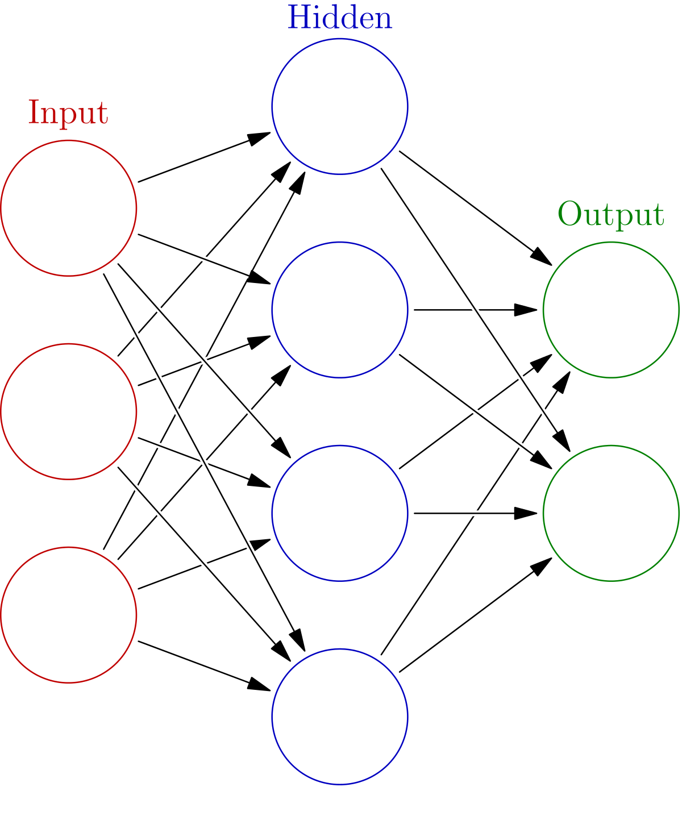
Hello World v2 (Demo)
3 neurons in the input layer
3 neurons in the (1) hidden layer
1 neuron in the output layer

Slide 7
Forward propagation
Z1 = W1 * A0 + b1
A1 = activation(Z1)
Z2 = W2 * A1 + b2
A2 = activation(Z2)
Y_hat = A2
Trainable Parameters:
W1
b1
W2
b2

Slide 8
Backward propagation
dZ2 = Y_hat – Y
dW2 = (1 / m) * np.dot(dZ2, A1.T)
db2 = (1 / m) * np.sum(dZ2, axis = 1, keepdims = 1)
dA1 = (W2.T, dZ2)
dZ1 = dA1 * g’(Z1) [REVERSE ACTIVATION]
dW1 = (1 / m) * np.dot(dZ1, A0.T)
db1 = (1 / m) * np.sum(dZ1, axis = 1, keepdims = 1)

Slide 9
Activations
 | ACTIVATION FUNCTIONS | DERIVATIVES
Sigmoid | 1 / 1 + e ^ -z | a * (1 – a)
tanH | e ^ z + e ^ -z / e ^ z + e ^ -z | 1 – a ^ 2
Rectified Liner Unit (ReLU) ** | max(0, z) | 0 if z < 0, 1 if z >= 0
Leaky ReLU | max(0.01z, z) | 0.01 if z < 0, 1 if z >= 0

Slide 10
Parameter update
W2 = W2 – alpha * dW2
b2 = b2 – alpha * db2
W1 = W1 – alpha * dW1
b1 = b1 – alpha * db1

Slide 11
MNIST Handwriting (Demo)
Input
Hidden
Output
28 x 28
IMAGE
784
512
10

Slide 12

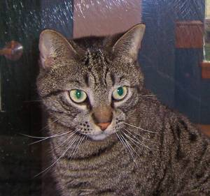
Cat vs Dog

